Slide 1
Nutritionist-Food-Recognition-Gemini-Pro
MADE BY :-
ARVIND DHAGE
SUSHANT NAMURTE

Slide 2
INTRODUCTION
The Nutritionist-Food-Recognition-Gemini-Pro projects merge nutrition expertise with advanced technology for personalized dietary guidance. Leveraging image recognition and machine learning, they enable accurate food analysis and tracking. This innovative approach empowers individuals to make informed choices and achieve their health goals. By combining human insight with AI capabilities, these projects offer a comprehensive solution for optimizing nutrition and wellness. They represent a groundbreaking fusion at the forefront of nutrition science and technology.

Slide 3
PROBLEM STATEMENT
Lack of Personalized Guidance.
Complex Food Choices.
Rising Diet-Related Health Issues.
Need for Accurate and Comprehensive Solutions.
Not easy to use, complex process.

Slide 4
COMPARISON
Normal Web App
Our Web App
Less Automated.
Contamination Risk.
Resource Inefficiency.
Limited Monitoring.
Complex To Use.
Automated Operation.
Correct Accuracy.
Resource Optimization.
Ease of Use.
Health Impact.

Slide 5
TECH STACK
Streamlit (Frontend).
Python (Backend).
Gemini AI.

Slide 6
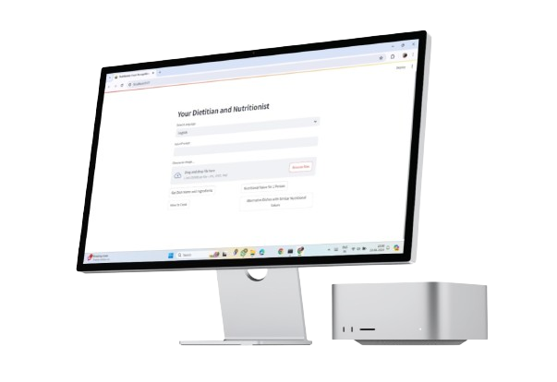
FINAL PROJECT

Slide 7
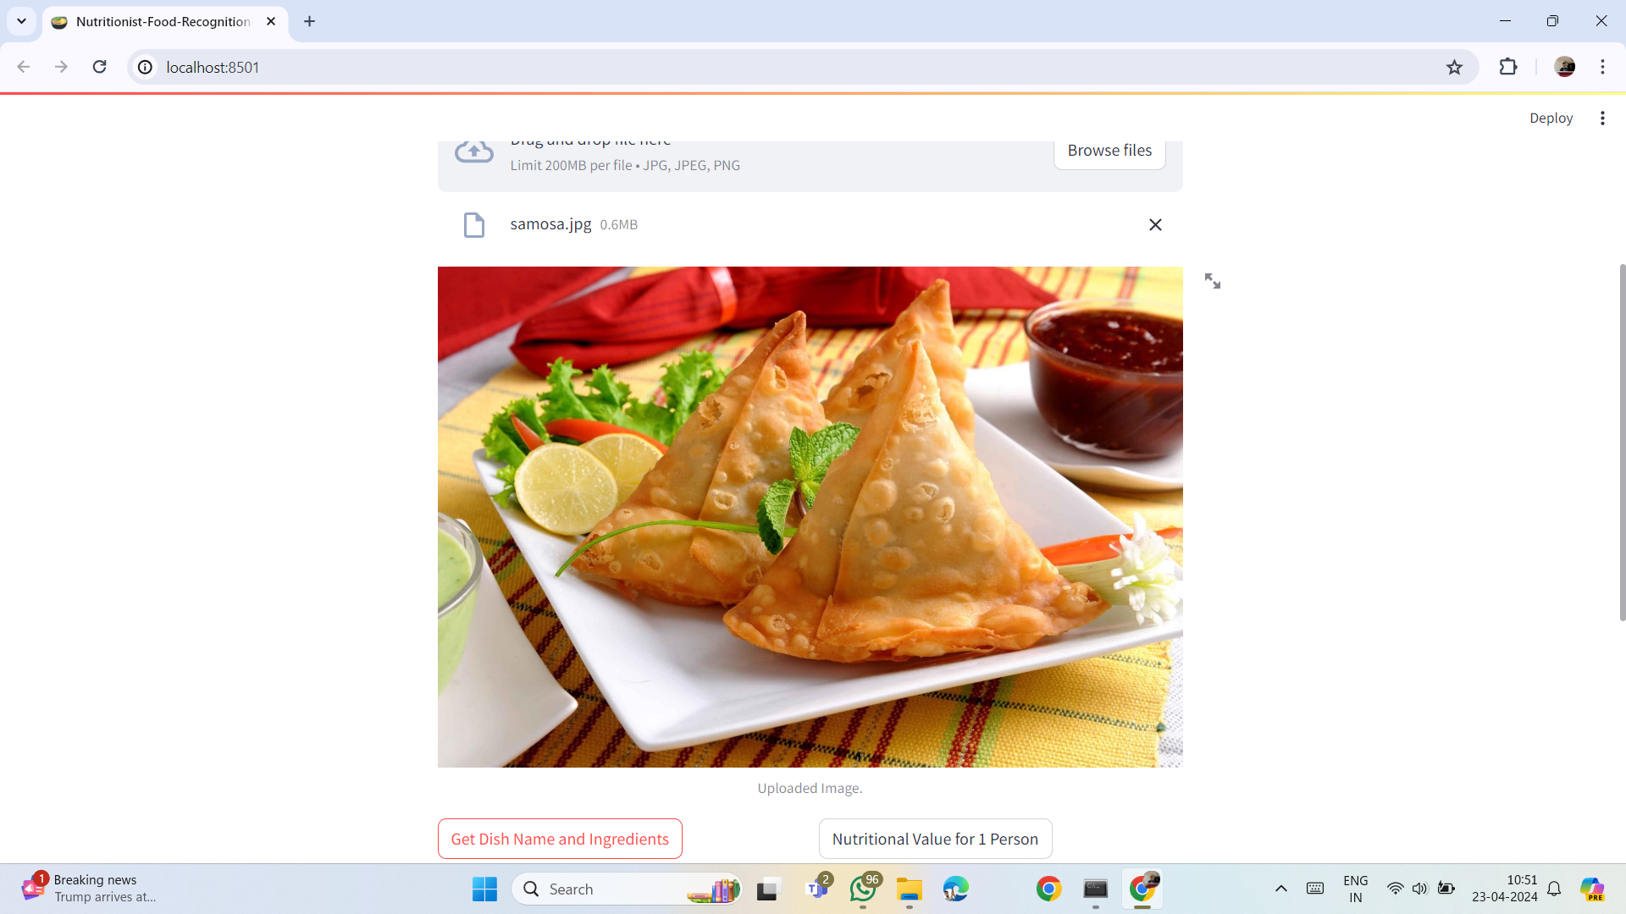
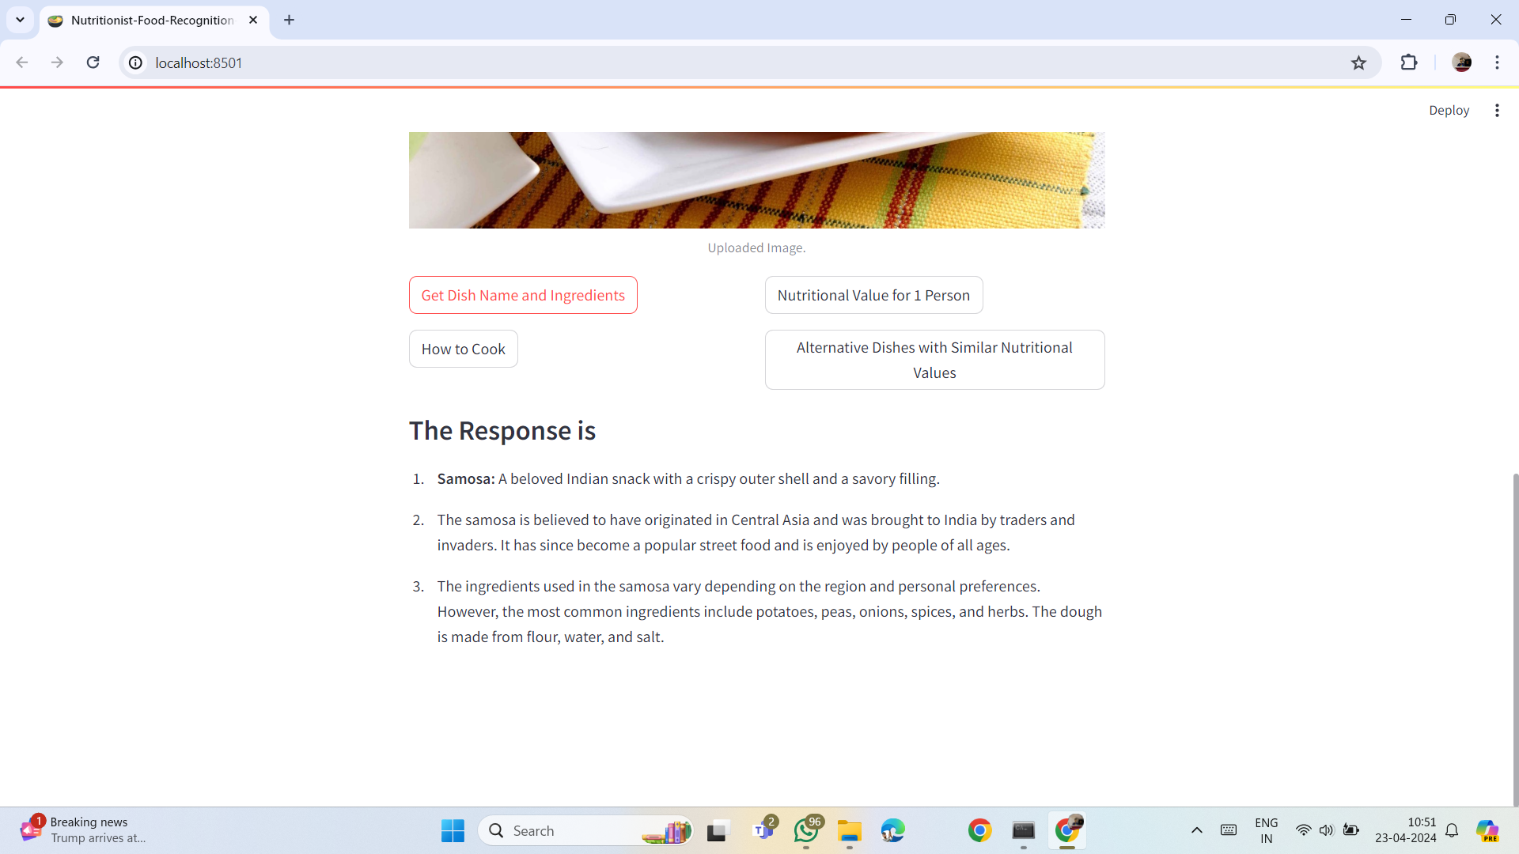

Slide 8
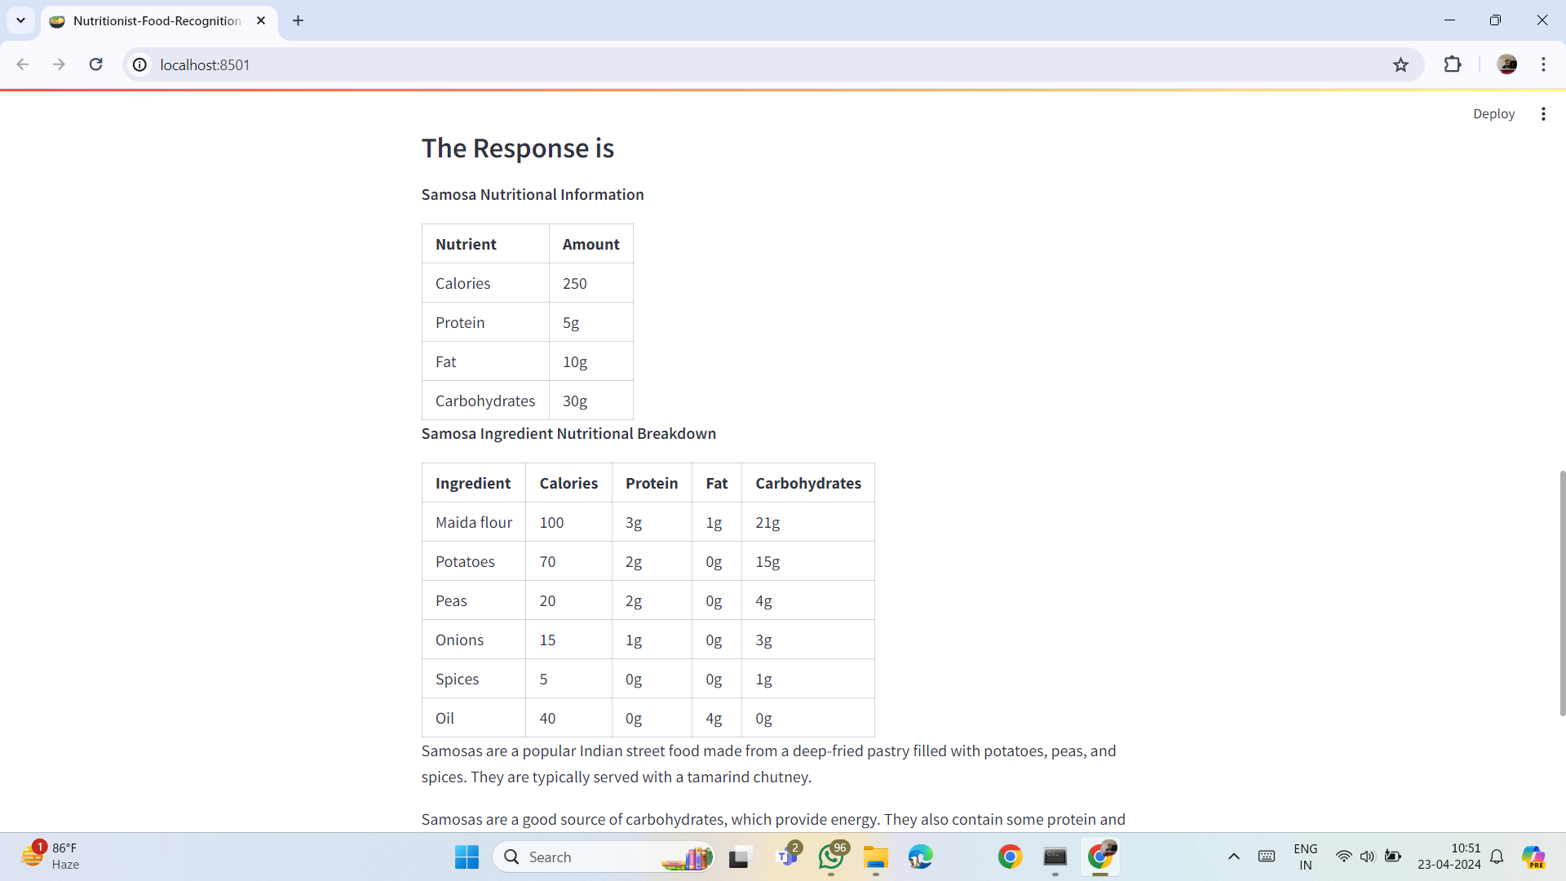
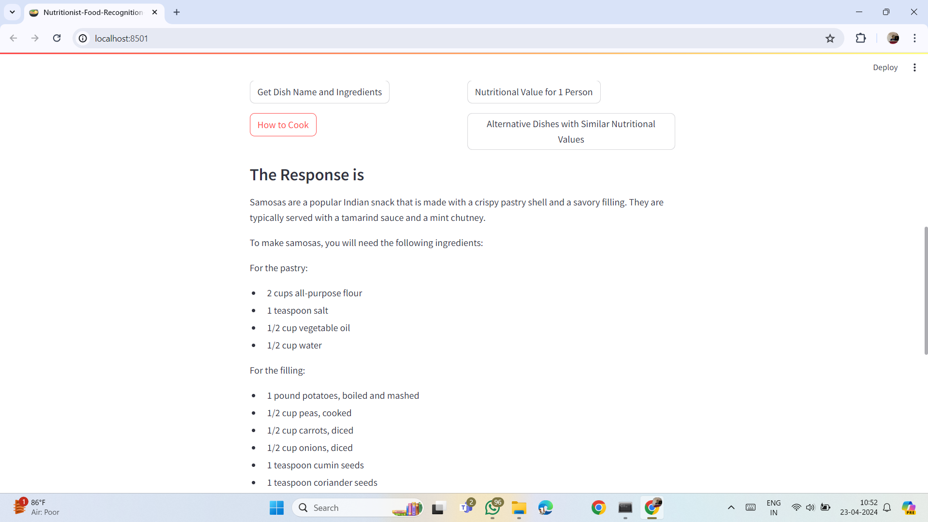

Slide 9
Thank You !

